Slide 1

Capstone Project
Google Play Store Data Analysis

Slide 2
Introduction
The Google Play Store hosts a vast ecosystem of mobile applications across diverse categories, serving millions of users worldwide. Understanding app performance, user engagement, and satisfaction is crucial for developers and businesses to stay competitive in this dynamic marketplace.
This project, Exploratory Data Analysis (EDA) on Google Play Store App Data, aims to uncover key insights into app characteristics, user feedback, and market trends. By analyzing metadata such as app ratings, installs, and pricing alongside user sentiment and reviews, this study highlights patterns and relationships that can guide app developers, marketers, and stakeholders in optimizing their offerings.

Slide 3
Problem Statement
For the project, the goal is to analyze two datasets: one containing basic app information (Play Store Data.csv) and the other with user reviews (User Reviews.csv). The objective is to explore and evaluate key factors such as ratings, category, and user feedback to identify the characteristics influencing app success and engagement in the Google Play Store.
An app's success can be determined by various factors such as:
High user ratings and positive feedback
A large user base with consistent engagement
High revenue generation, both through direct sales and in-app purchases
Positive user reviews and high ratings on different platforms

Slide 4
Agenda
Introduction
Data Overview
Data Preprocessing
-Handling missing values
-Data cleaning and transformation
-Exploratory data analysis (EDA)
4. Factors Influencing App Success
5. Results and Findings
- Top 10 Categories having highest ratings
- Number of Application in terms of Category
- Top 10 apps
- 10 apps from 'Family' category having highest rating and downloads
- Which Category has highest number of installs?
- Free and Paid Apps

Slide 5
Agenda
6. Sentiment analysis of user reviews
- Sentiment Distribution
- Sentiment Polarity Analysis
- Subjectivity Analysis
- Relationship Between Sentiments and Polarity
- Sentiment Distribution Across Categories
- Average Sentiment Polarity by App Type
- App-wise Sentiment Summary
7. Conclusion

Slide 6
Dataset Preparation
Loading the Datasets: Import the two datasets—Play Store app dataset and User Reviews dataset.
Importing Required Libraries: Utilize libraries like NumPy, Pandas, Seaborn, and Matplotlib for data manipulation, analysis, and visualization.
Data Cleaning: Handle missing data by checking for null values, detecting and removing outliers, and eliminating duplicate entries to ensure the dataset’s accuracy.
Data Imputation: Replace missing categorical values with the mode and numerical values with the median. Additionally, convert columns such as price, installs, and reviews into numerical values for consistency.
Exploratory Data Analysis (EDA): Explore the datasets to identify key patterns and trends, summarizing the main characteristics through statistical graphics and data visualization techniques.

Slide 7
Attributes in Google Play store Data
App: The name of the mobile application.
Category: The category or genre of the app (e.g., Education, Lifestyle).
Rating: The average user rating of the app on a scale (e.g., 1 to 5).
Reviews: The total number of user reviews for the app.
Size: The file size of the app (e.g., in MB or KB).
Installs: The total number of times the app has been downloaded.
Type: Indicates whether the app is Free or Paid.
Price: The price of the app (e.g., in dollars), or 0 for free apps.
Content Rating: The age group for which the app is suitable (e.g., Everyone, Teen).
Genres: A more specific classification of the app (e.g., Arcade, Puzzle).

Slide 8
Attributes in Google Play store Data
Last Updated: The date when the app was last updated.
Current Ver: The current version of the app.
Android Ver: The minimum Android version required to run the app.

Slide 9
Attributes in User reviews
App: The name of the mobile application associated with the review.
Translated Review: The user review text, translated into English.
Sentiment: The overall sentiment of the review (e.g., Positive, Negative, Neutral).
Sentiment Polarity: A numeric score indicating the positivity or negativity of the sentiment (range: -1 to 1).
Sentiment Subjectivity: A numeric score indicating the degree of subjectivity in the review (range: 0 to 1).

Slide 10
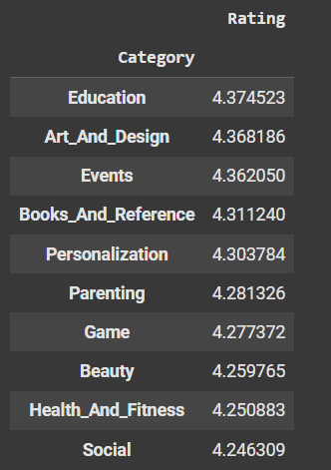
Top 10 Categories having Highest rating
‘Education’, ‘Art and Design’ and ‘Events’ have highest rating.

Slide 11
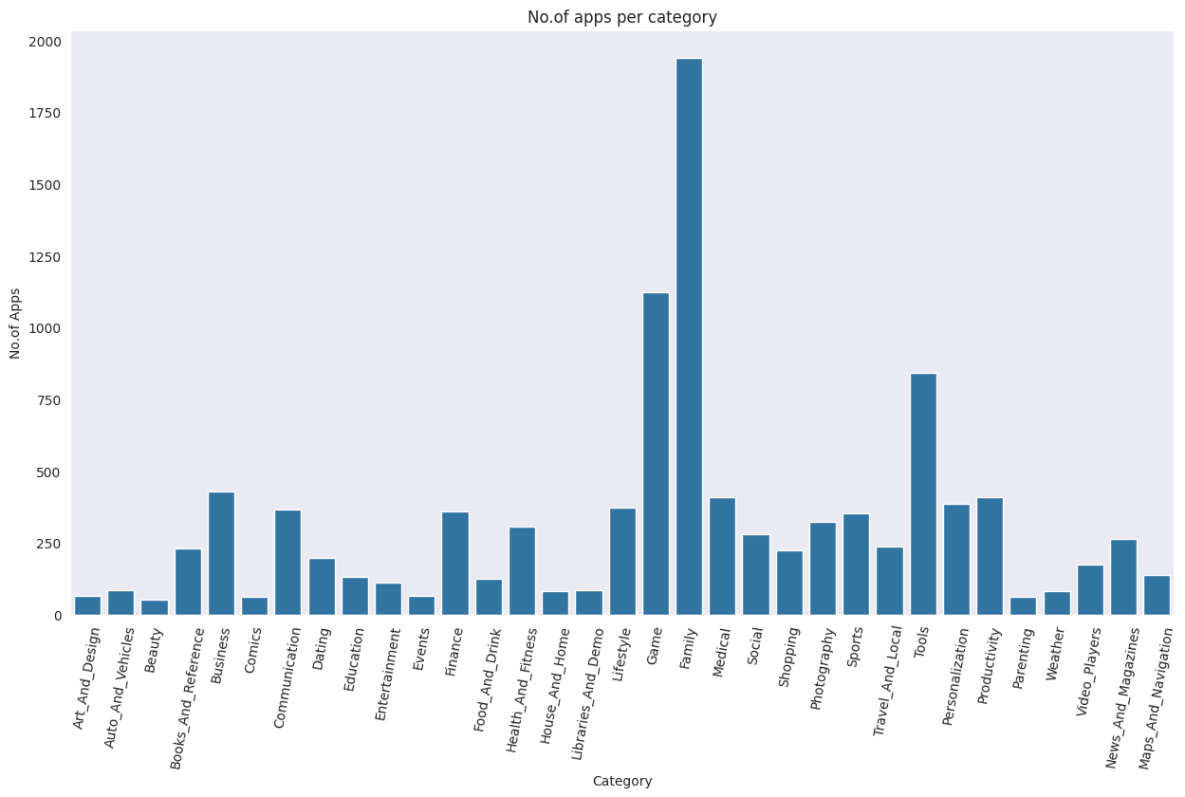
Number of Application in terms of Category
Family and Game apps have the
highest market prevalence. Surprising Tools, Business and Medical apps are also at the Top Count of applications.

Slide 12
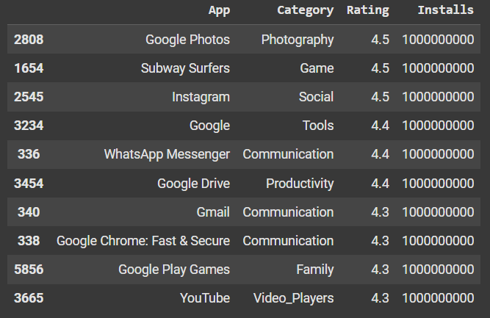








Top 10 apps in terms of highest installs and Rating

Slide 13


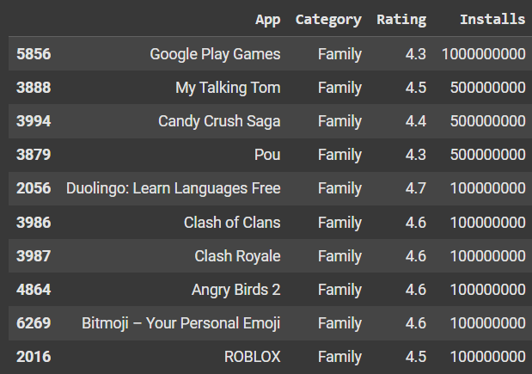


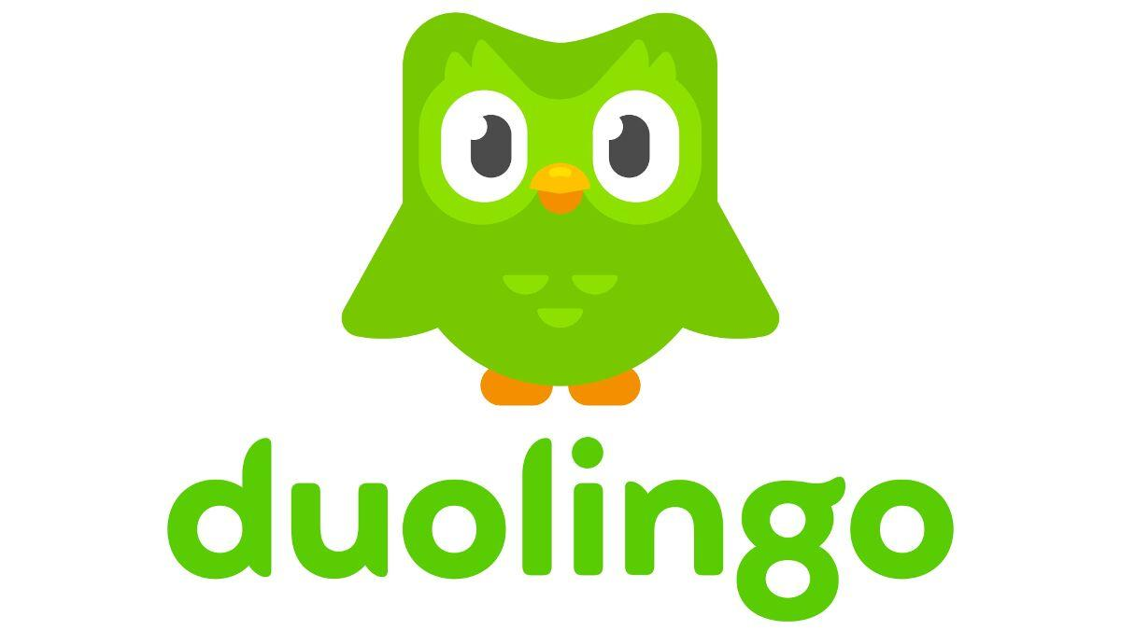


Top 10 apps from 'Family' category having highest rating and downloads

Slide 14
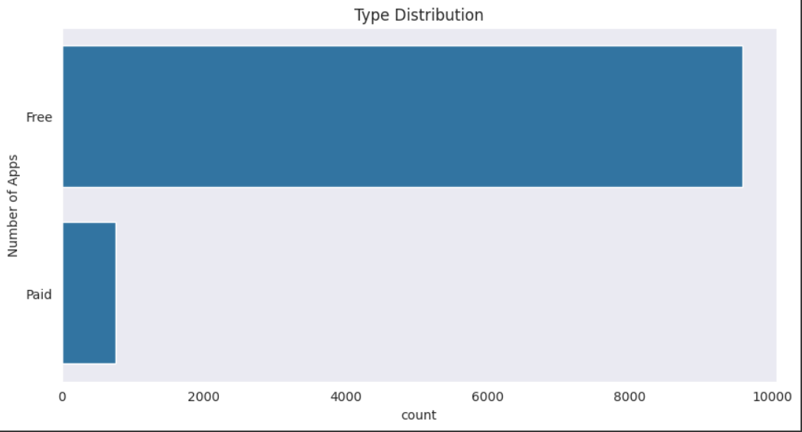
Free and Paid Apps
When comparing the two plots, it’s evident that users are more interested in free apps, especially in categories like Art & Design, with over 10,000 free apps available.
On the other hand, for commercial purposes, people tend to favor apps in categories such as Business, Communication, and Personalization. However, the number of paid apps in these categories is significantly lower than the number of free apps.

Slide 15
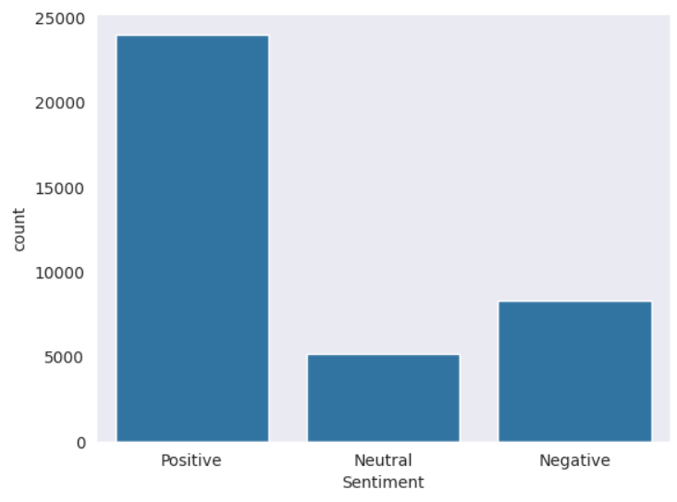
Sentiment Distribution
The graph illustrates the distribution of user sentiments. Positive sentiments dominate with approximately 25,000 entries, indicating a largely favorable user experience. Neutral sentiments account for around 5,000, showing moderate feedback, while negative sentiments, at roughly 10,000, highlight areas for improvement.

Slide 16
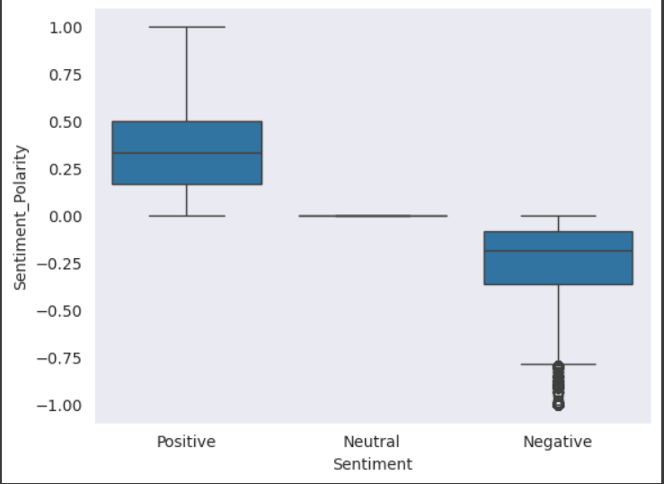
Relationship Between Sentiments and Polarity
The relationship between sentiments and polarity highlights how user feedback aligns with positivity, neutrality, or negativity. Positive sentiments are linked to high polarity values, neutral sentiments center around zero polarity, and negative sentiments correspond to low polarity. This relationship helps quantify user opinions and provides insights into app performance and satisfaction.

Slide 17
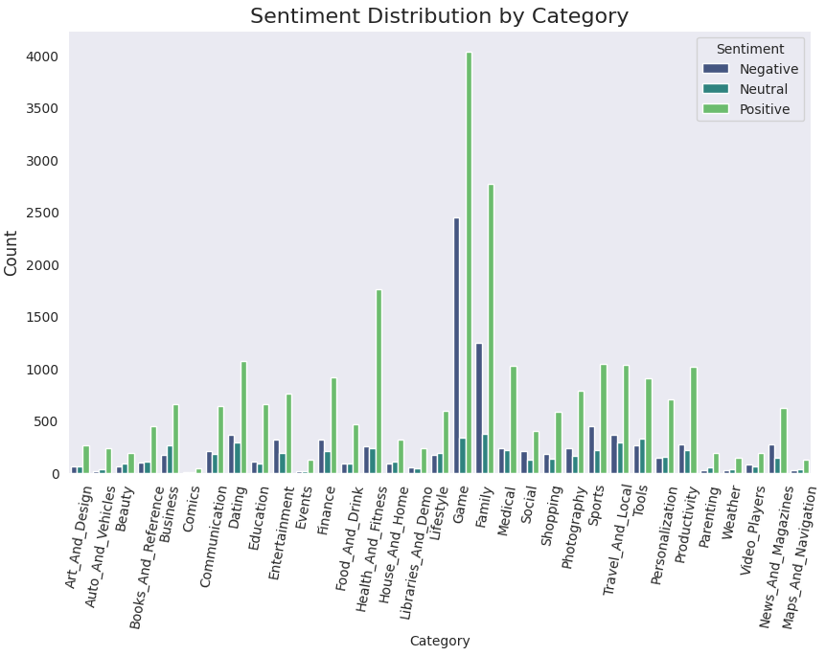
Sentiment Distribution Across Categories
This graph displays the distribution of sentiments (Negative, Neutral, Positive) across various categories. It shows that some categories, like "Family" and "Lifestyle," have a higher number of positive reviews, while others show a more balanced or lower sentiment distribution. Positive sentiments generally dominate across most categories.

Slide 18
Challenge Faced
Reading the dataset and comprehending the problem statement – Understanding the dataset structure, identifying key variables, and defining the project goals.
Handling errors, duplicates, and NaN values – Cleaning the dataset by removing or imputing missing values and ensuring data consistency.
Designing multiple visualizations – Creating insightful visualizations to summarize trends, highlight patterns, and effectively communicate results to the reader

Slide 19

Conclusion
After analyzing the dataset, we have got answers to some of the serious & interesting facts which any of the android users would love to know.
- Top 10 Categories having highest ratings
- Number of Application in terms of Category
- Top 10 apps
- 10 apps from 'Family' category having highest rating and downloads
- Which Category has highest number of installs?
Free and Paid Apps
- Relationship Between Sentiments and Polarity
- Sentiment Distribution Across Categories

Slide 20


Slide 21
Customer Satisfaction Prediction Machine Learning Project

